Slide 1



Turning COVID-19 Data into Actionable Insights
A Data-Driven Exploration Using the Flatten_Covid19_Dataset
By
TEAM8_PYMASTER
Team Members
Neetu
Elavarasi
Vipula
Subbulakshmi
Infanta

Slide 2


PROJECT OVERVIEW
Goal
To analyze the Flatten_Covid19_Dataset to uncover meaningful patterns between symptoms, demographics, medical conditions, and COVID-19 positivity, enabling early risk identification and data-driven public health decisions.
Data Sources:
schema_1
schema_2
schema_3

Slide 3

Git & GitHub Collaboration
Git and GitHub were used for version control, collaboration, and code management, ensuring a structured and transparent team workflow.
How We Used GitHub
Centralized Repository: Maintained a single GitHub repository to store datasets, notebooks, scripts, and documentation.
Version Control: Tracked all code changes through commits, enabling easy rollback and progress monitoring.
Team Collaboration: Each team member cloned the repository locally and contributed through regular commits.
Commit Quality: Used meaningful commit messages to clearly document changes and improvements.
Conflict Management: Git ensured safe merging of parallel work without overwriting teammates’ contributions.
🔹 Workflow Followed
Install Git / GitHub Desktop
Clone the shared repository locally
Work on assigned tasks
Commit changes with clear messages
Push updates to GitHub
t
tt

Slide 4
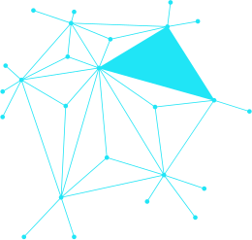

INTRODUCTION
Uses the Flatten_Covid19_Dataset, integrating testing outcomes, reported symptoms, demographics, and vulnerability indicators.
Includes synchronized information on COVID test results, symptom presence, age groups, medical conditions, and exposure risk factors.
Focuses on identifying high-risk symptom clusters associated with increased COVID-19 positivity.
Evaluates how demographic and health factors influence infection likelihood and severity.
Aims to support early testing prioritization, targeted interventions, and data-driven public health decision-making.

Slide 5

Data Cleaning & Preparation
Removed duplicate records and retained only the most recent test entry per individual.
Standardized column names, data types, and categorical values for consistency.
Handled missing and invalid values by applying logical imputation or exclusion where necessary.
Converted symptom indicators into binary features to enable accurate analysis.
Merged multiple data schemas (symptoms, testing, demographics) using common identifiers.
Filtered out incomplete or inconsistent records to ensure data reliability and integrity.

Slide 6
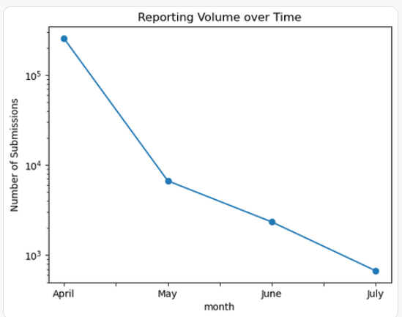
Descriptive Analysis
How did the reporting volume change from April to July?
Reporting volume declined sharply from April to July, dropping from very high participation in April to minimal submissions by July.
Interpretation (Survey Fatigue):
The steep and continuous decrease suggests survey fatigue, where users gradually stopped reporting over time.
Why This Matters:
If actual COVID cases were rising while reporting volume fell, the surveillance app’s ability to accurately track population-level trends weakened, potentially underestimating true case burden.
Implication:
Sustained engagement strategies are critical to maintain the effectiveness of digital health surveillance tools over long periods

Slide 7
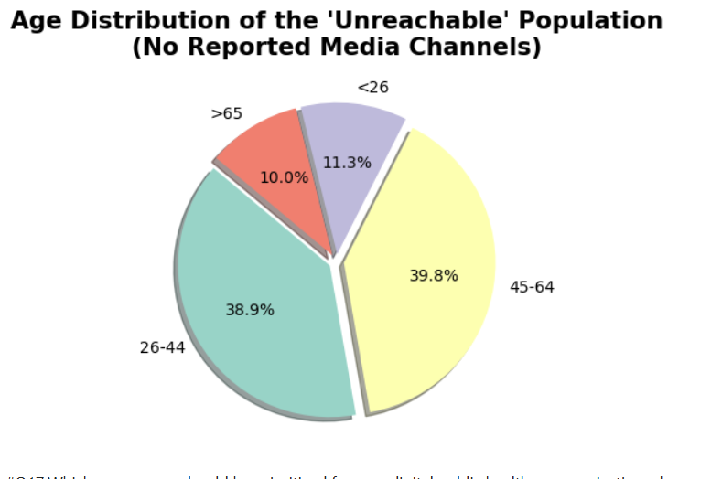
Prescriptive Analysis
Prescriptive analysis provides a data-backed roadmap to solve problems. It answers 'What should we do?' by simulating scenarios and recommending the specific actions that yield the best public health outcomes
Identifying the Information Gap: The "Unreachable" Demographic
Working-Age Majority: The vast majority of the "unreachable" population (78.7%) falls within the active workforce age range of 26 to 64 years old.
The 45-64 Segment: This group represents the largest information gap at 39.8%, indicating a significant failure in reaching middle-aged decision-makers and caregivers through digital-only means.
The 26-44 Segment: Closely following at 38.9%, this group highlights a potential "news avoidance" or reliance on non-traditional, word-of-mouth information sources.
The Senior Connection: Contrary to common assumptions, the >65 group is the smallest unreachable segment at 10.0%, likely because they remain well-connected to traditional broadcast media like TV and radio.

Slide 8
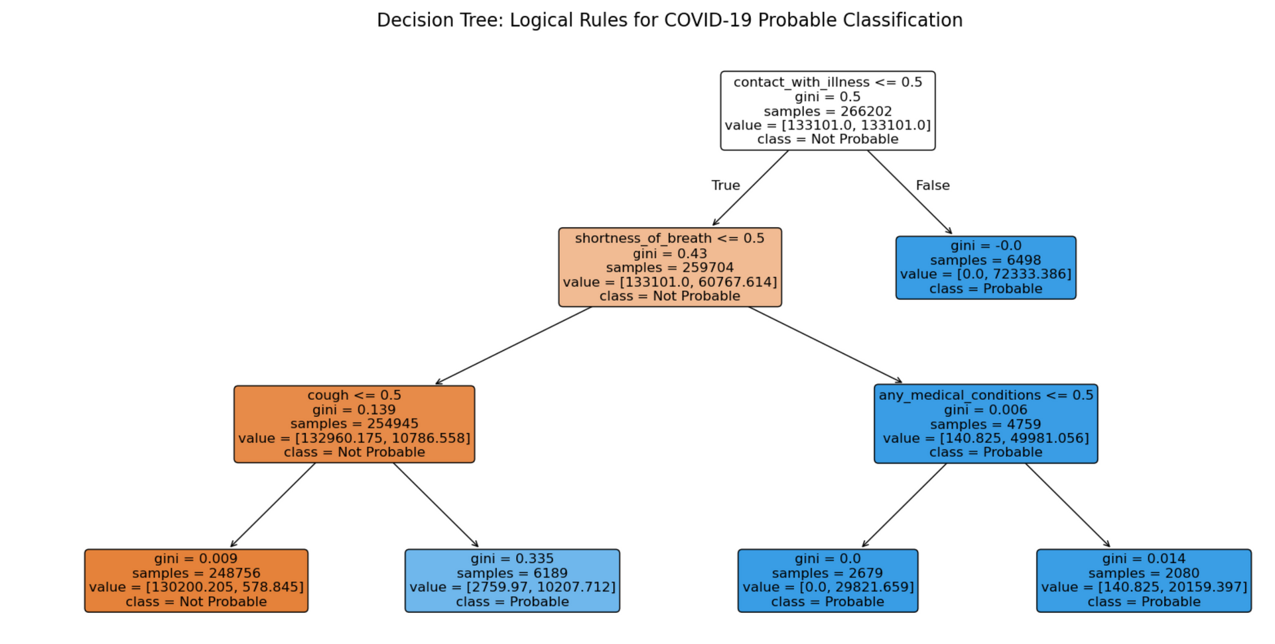

Predictive Analysis

Slide 9


Page 13
-

